Slide 1
PYTHON FINAL PROJECT — CASE 3
Personal Finance
Tracker
A Python application to track income, expenses, and detect overspending
Berdibek Meirbek | Altair Abdraisov | Daryn Yerbol | Mirzatayev Bagdaulet

Slide 2
💰
📊
Problem
Statement
Transactions
Categories
Add income &
expense records
Food, transport,
bills & more
Project Idea
Most people don't track their daily income and expenses — and end up overspending without realizing it.
📅
⚠️
Monthly Report
Budget Alert
Monthly income
vs expense summary
Detect when
spending exceeds limit

Slide 3
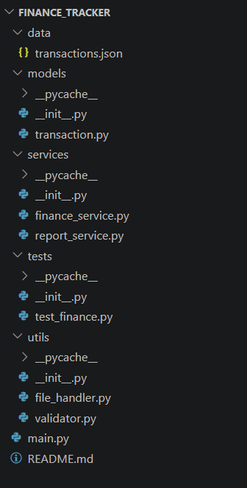
Project Architecture — File Structure
📁 finance_tracker/
main.py
Entry Point
CLI menu, user input handling,
program flow control
📄 main.py
📁 models/
models/
OOP Classes
transaction.py
Transaction, Expense, Income
class hierarchy
📁 services/
finance_service.py
report_service.py
services/
Business Logic
📁 utils/
Balance, filtering, reports,
overspending detection
file_handler.py
validator.py
utils/
Utilities
📁 tests/
JSON file I/O, regex validation,
category checks
test_finance.py
📁 data/
tests/
Unit Tests
transactions.json
20 unit tests using
unittest module

Slide 4
OOP — Class Hierarchy
Transaction
_type, _amount, _date
_category, _description
get_type() get_amount() to_dict()
inheritance
Expense(Transaction)
Income(Transaction)
super().__init__("expense", ...)
is_large(threshold=200)
category is a required field
super().__init__("income", ...)
is_large(threshold=2000)
category assigned automatically
⚡ Polymorphism: is_large() — same method name, different threshold per class

Slide 5
Advanced Python Features
01
Generator
def expense_generator(self):
for t in self._transactions:
if t.get_type() == "expense":
yield t
yield — memory efficient.
No new list created, items
delivered one by one.
02
Lambda + Filter + Map
filter(lambda t: t.get_type()=="income",
transactions)
map(lambda t: t.get_amount(), ...)
Filter transactions by type,
extract amounts — functional
programming style.
03
Regular Expressions (Regex)
pattern = r"^\d{4}-\d{2}-\d{2}$"
if not re.match(pattern, date_str):
raise ValueError(...)
Validates YYYY-MM-DD date
format. \d{4} = exactly
4 digits.

Slide 6
Data Structures — Why We Chose Each
📋 List
📖 Dictionary
self._transactions = []
totals[cat] = totals.get(cat, 0) + amount
Transactions are ordered — chronological order matters. append() is O(1).
Category totals — O(1) key lookup. Using a list would be O(n²).
🔵 Set
📦 Tuple
VALID_CATEGORIES = {"food","transport",...}
warnings.append((category, spent, limit))
Category validation is O(1). Checking "food" in a set is instant.
Budget warning — 3 values grouped, immutable. Tuple is ideal for read-only records.

Slide 7
Algorithmic Efficiency
❌ BAD APPROACH — O(n²)
✅ GOOD APPROACH — O(n)
categories = []
for t in transactions:
found = False
for c in categories:
if c["name"] == t.category:
c["total"] += t.amount
found = True
if not found:
categories.append({...})
totals = {}
for t in self.expense_generator():
cat = t.get_category()
totals[cat] = totals.get(cat, 0)
+ t.get_amount()
→
1000 transactions × 7 categories = 7000 comparisons!
1000 transactions = 1000 steps. That's it!
Why is dict efficient?
🔑
Dict uses a hash table internally — finds keys instantly, no scanning
⚡
totals.get("food", 0) is O(1). Searching a list ["food",...] is O(n)
💡
Set also uses hashing — VALID_CATEGORIES membership check is O(1)

Slide 8
File Handling — JSON Storage
transactions.json — sample
📂
App starts up
[
{
"type": "income",
"amount": 1500,
"date": "2026-05-01",
"description": "Monthly salary"
},
{
"type": "expense",
"category": "food",
"amount": 45,
"date": "2026-05-02",
"description": "Groceries"
}
]
data = load_transactions(DATA_FILE)
🔄
Dict → Object conversion
fs.load_from_data(data)
➕
Add / modify transactions
fs.add_expense(amount, date, cat)
💾
Save on exit (press 0)
save_transactions(DATA_FILE, ...)
💡 with open(...) — automatically closes the file, no need for f.close()

Slide 9
Unit Tests — tests/test_finance.py
20
TestTransactionModels
TestFinanceService
TestValidators
4 tests
8 tests
8 tests
tests passed ✓
✓ expense_creation
✓ get_balance()
✓ valid_amount
✓ income_creation
✓ add_transaction_count
✓ negative_amount
✓ is_large()
✓ category_totals
✓ text_amount
✓ to_dict()
✓ filter_by_month
✓ valid_date
✓ overspending
✓ invalid_date
✓ no_overspending
✓ valid_category
✓ delete_last
✓ invalid_category
✓ empty_balance
✓ case_insensitive
Ran 20 tests in 0.004s OK ✓ All tests passed!

Slide 10
Team Contribution
Mirzatayev Bagdaulet
Models — OOP
Berdibek
FinanceService + Report
models/transaction.py
finance_service.py, report_service.py
▸ Transaction base class
▸ get_balance(), add_expense/income
▸ Expense class (inheritance)
▸ expense_generator() — generator
▸ Income class (polymorphism)
▸ get_category_totals() — dict O(n)
▸ to_dict(), __str__() methods
▸ detect_overspending(), all reports
Altair Abdraisov
Tests + main.py
Daryn Yerbol
Utils + Tests
tests/test_finance.py, main.py
utils/file_handler.py, validator.py
▸ 20 unit tests (unittest module)
▸ load/save JSON — file handling
▸ setUp(), assertAlmostEqual()
▸ validate_date() — regex pattern
▸ CLI menu & program flow
▸ validate_category() — set O(1)
▸ get_input() with validation
▸ validate_amount() — error handling

Slide 11
Project Deliverables:
✓ 5 classes — Transaction, Expense, Income, FinanceService, ReportService
✓ OOP: encapsulation, inheritance, polymorphism — fully implemented
✓ Generator, lambda, filter, map, regex — Advanced Python features
✓ Dict O(n), Set O(1) — algorithmic efficiency justified
✓ JSON file read/write — File Handling with error handling
✓ 20 unit tests — all PASSED (unittest module)
Thank you for your attention

